Slide 1

Insurance management System
The Insurance Management System is a microservices-based project that manages insurance policies and claims.
Users can apply for policies and raise claims, agents manage and verify them, while admins finalize approvals.
The system is containerized using Docker, deployed and managed with Kubernetes, and automated through Jenkins CI/CD.

Slide 2

Architecture
microservices
The project follows a Microservices Architecture, where each functionality is developed as a separate service.
Each service runs on its own port and has its own database, making them independent and scalable.
An API Gateway is used as a single entry point to route requests to the right service.
Services communicate using REST APIs.
The system is packaged into Docker containers and deployed using Kubernetes for orchestration.
Jenkins CI/CD automates building, testing, and deploying all services.

Slide 3

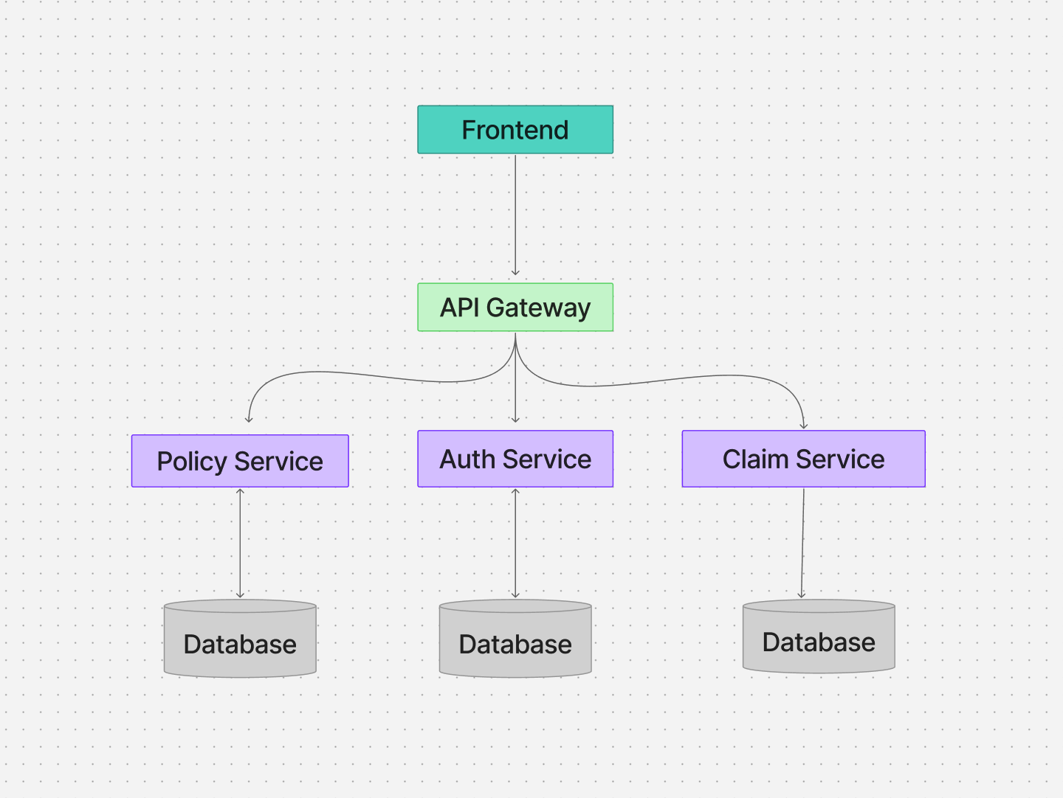
Architecture

Slide 4

Auth-Service
Overview each services and present api's exposed
Overview:
Handles authentication and authorization.
Manages users, agents, and admins with role-based access.
APIs:
POST /register → Register a new user/agent.
POST /login → Login and get authentication token.
GET /users → List all registered users (admin only).
GET /users/{id} → Get details of a user.

Slide 5

Policy-Service
Overview:
Manages insurance policies.
Users can apply for policies.
Agents review applications.
Admins finalize approvals.
APIs:
GET /policies → Get all policies.
GET /policies/{id} → Get details of one policy.
POST /policies → Apply for a new policy.
PUT /policies/{id} → Update policy (agent/admin).
DELETE /policies/{id} → Cancel a policy.

Slide 6
Overview:
Handles insurance claims.
Users raise claims for approved policies.
Agents verify claims.
Admins take the final decision.
APIs:
GET /list-claims → Get all claims.
POST /Create-claims → Raise a new claim.
PUT /claims/{id} → Update claim status (agent/admin).
DELETE /claims/{id} → Remove a claim.
Claim-Service

Slide 7
API Gateway
Overview:
Acts as the single entry point for all clients (User, Agent, Admin).
Forwards requests to the right microservice (auth-service, policy-service, claim-service).
Provides centralized authentication, routing, and security.
Makes the system easier to use and more secure.
APIs (routes exposed):
POST /auth/register → Forward to Auth-Service (register a user/agent/admin).
POST /auth/login → Forward to Auth-Service (login ).
GET /policies → Forward to Policy-Service (list all policies).
POST /policies → Forward to Policy-Service (apply for new policy).
GET /claims → Forward to Claim-Service (list all claims).
POST /claims → Forward to Claim-Service (raise a new claim).

Slide 8
Containerization – Docker
Each service is packaged into a Docker container.
Containers make the system lightweight, portable, and consistent across environments.
Every service runs in its own container with its dependencies.
Containers communicate with each other through Docker networking.
Containers Created:
API Gateway Container → Handles routing and authentication.
Auth-Service Container → Manages login, registration, and role-based access.
Policy-Service Container → Handles insurance policy applications.
Claim-Service Container → Manages insurance claims.
Frontend Container → Provides UI for Users, Agents, and Admins.

Slide 9

Jenkins in the Architecture :
It automates the CI/CD pipeline:
Watches the GitHub repo for code changes.
Builds Docker images for each microservice.
Runs tests to ensure services work correctly.
Deploys the containers to Docker Compose or Kubernetes.

Slide 10
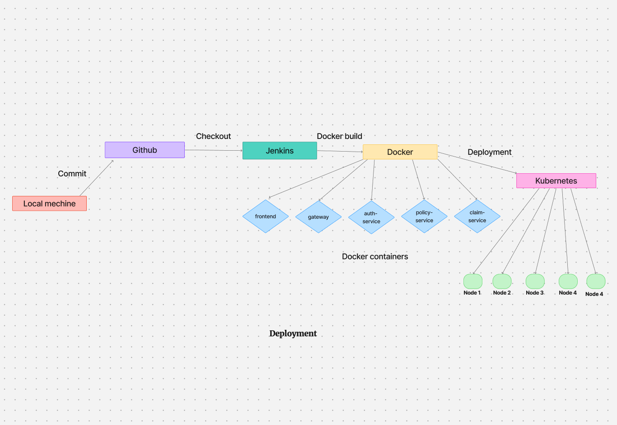
Deployment
Deployment
The system is deployed using Docker Compose (for local setup) and Kubernetes (for orchestration in production).
Jenkins CI/CD pipeline automates deployment by building Docker images, running tests, and deploying containers.
Each microservice runs in its own container with its dependencies.
Kubernetes manages scaling, load balancing, and service discovery.

Slide 11

THANK YOU
Sourav Roy
ID - 30437
roys45545@gmail.com

